Slide 1


Smart Slides
Make Slides in a flash
How to use Smart Slides

Slide 2
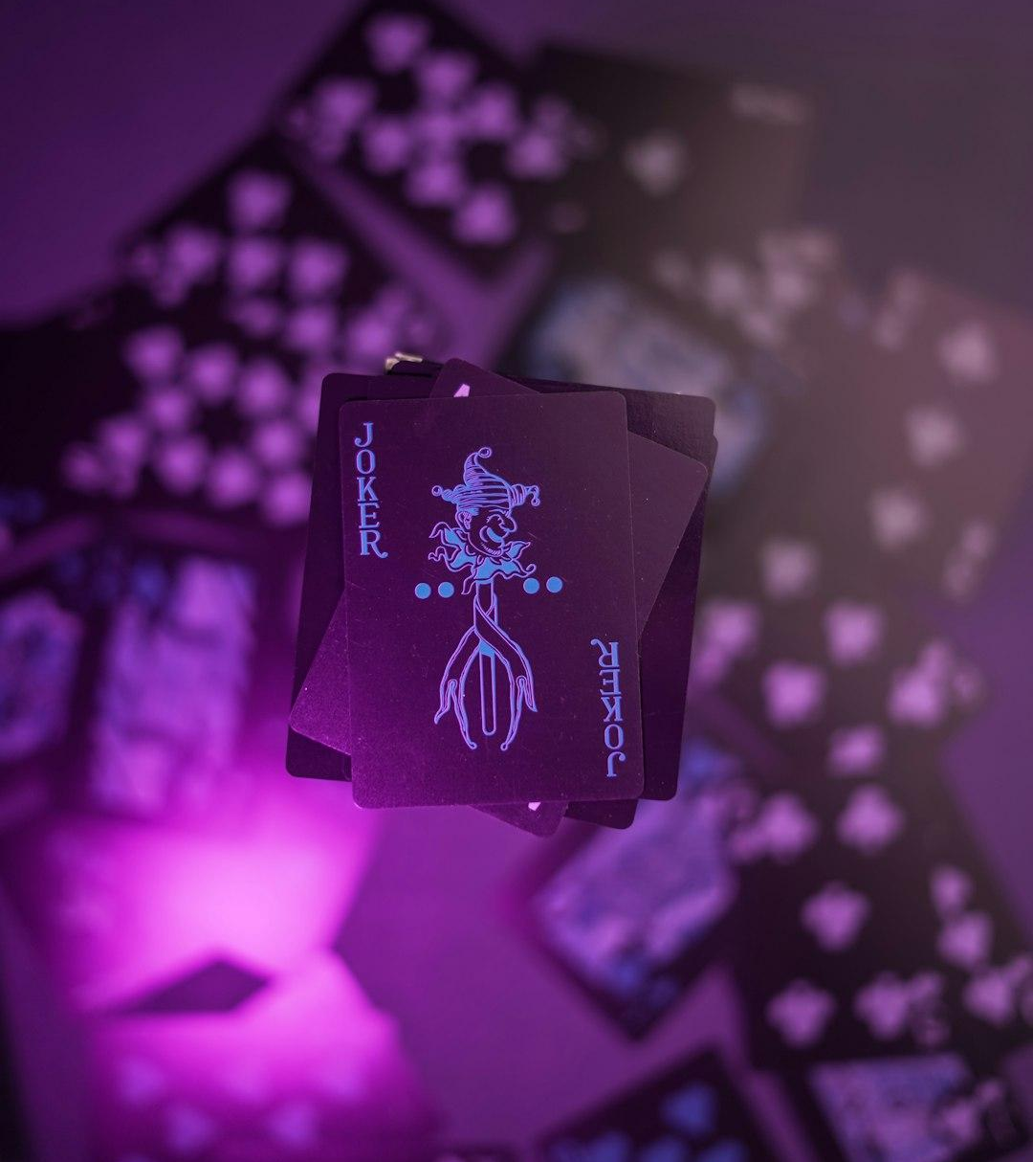
STEP 1 - GOAL
Clarify the mission and purpose.
Define what success looks like.
Photo: black and white star print gift box
Photo by Shyam Mishra
Powered by Unsplash

Slide 3

STEP 2 - MAX THINGS OUT
Push limits in every domain.
No ceiling on ambition — max energy, max creativity.
Photo: a close up of a business card on a table
Photo by Mockup Free
Powered by Unsplash

Slide 4

A - SPOTIFY
Spotlight on Spotify’s ecosystem and potential.
Leverage algorithms, playlists, and data to amplify reach.
Photo: a close up view of a purple background
Photo by engin akyurt
Powered by Unsplash

Slide 5

B - CONTENT
Build storytelling that connects.
Quality, consistency, and voice that cuts through noise.
Photo: a close up of a purple object on a white surface
Photo by Yordan Stoyanov
Powered by Unsplash

Slide 6

C - THE CONNECTIONS
Leverage relationships, networks, and partnerships.
Synergy drives scale.
Photo: a group of bubbles floating in the air
Photo by Enis Can Ceyhan
Powered by Unsplash

Slide 7

NEW PHASE
Enter a new era of strategy and execution.
Bold moves, refined focus.
Photo: A purple background with a lot of silver triangles
Photo by Logan Voss
Powered by Unsplash

Slide 8

STEP 6 - THAT’S WHY WE DO A WEEKLY CALL
Accountability, rhythm, and feedback.
Every week = new momentum.
Photo: A textured purple background with horizontal lines
Photo by Logan Voss
Powered by Unsplash

Slide 9
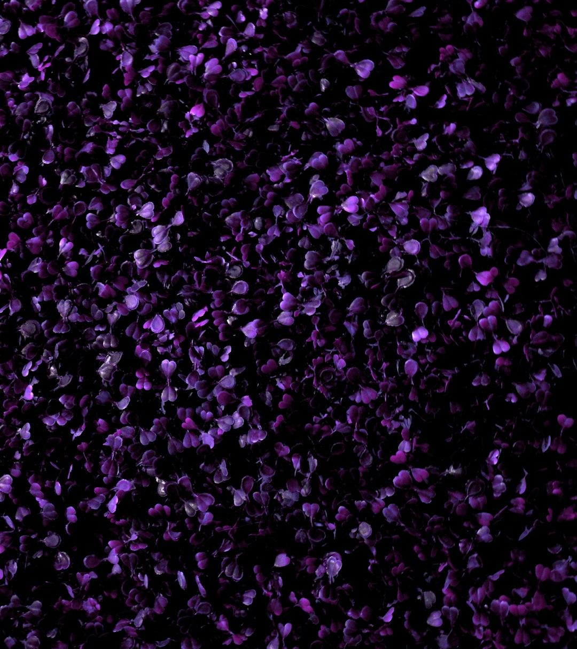
STEP 7 - LONG-TERM PLAN
Vision for sustainable growth.
Map milestones — build future resilience.
Photo: purple and white flower petals
Photo by Chirayu Trivedi
Powered by Unsplash

Slide 10

STEP 8 - RETURN ON RESULTS
Measure, analyze, and celebrate performance.
Data-driven wins.
Photo: A textured purple background with vertical lines
Photo by Logan Voss
Powered by Unsplash

Slide 11

STEP 9 - RECAP LAST YEAR / PLAN THIS YEAR
Reflect on past successes and lessons.
Define clear next steps and targets.
Photo: purple textile in close up photography
Photo by Tamanna Rumee
Powered by Unsplash

